Slide 1


Eve-Teasing Detection from Image using Computer Vision and Artificial Intelligence In Public Transport
Project Mentor : Mrs. Papri Ghosh
Presented By :
Taniya Naskar (10330522006)
Subhasree Santra (10330522005)
Anupam Biswas (10330522002)

Slide 2
Introduction
Eve-teasing in public transport poses a serious safety threat.
Traditional surveillance lacks real-time intelligent detection.
This project leverages computer vision and AI to automate identification of inappropriate behaviors.

Slide 3
Problem Statement
Challenges:
Delayed response
Manual monitoring
Underreporting
No real-time analysis
Solution:
YOLOv8 for real-time harassment detection.

Slide 4
Literature Review
Studies focus on behavior detection and video surveillance.
Use of CNNs and YOLO in similar domains (harassment, anomaly detection).
Gap: Limited work on dedicated eve-teasing detection in public transport.

Slide 5
Objectives
Problem: Lack of intelligent, real-time detection in public surveillance.
Train a model to classify images as 'normal' or 'eve-teasing’.
Create labeled dataset
Use YOLOv8 for fast and accurate inference.
Provide a GUI for testing and showcasing results.

Slide 6
System Design
Input: Video/Image
Process: Preprocessing → Feature Extraction → Detection
Output: Classification + Alert
Tech: Python, YOLOv8, OpenCV, Tkinter

Slide 7
Dataset and Preprocessing
550+ images: 'normal' & 'eve-teasing'
Preprocessing: Resizing, augmentation, normalization.
Challenges: Small size and class imbalance.
Collected from public sources
Annotated with bounding boxes
Augmented to 2000+ images

Slide 8
Model and Tools Used
YOLOv8 – used for classification.
PyTorch – model training and inference.
Tkinter – GUI for image testing.
OpenCV – Image preprocessing.

Slide 9
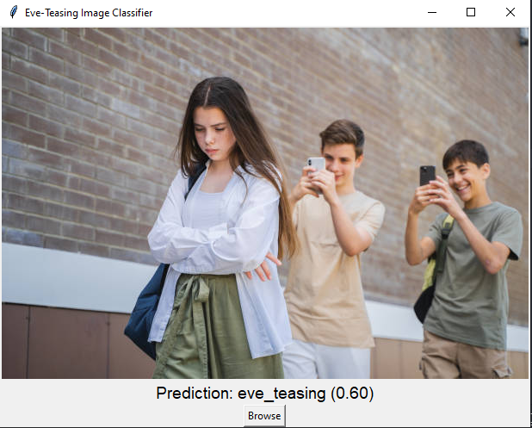
GUI Implementation
Built with Tkinter
Functions:
Upload Image
Show Label & Confidence
Trigger Alerts
Real-time support

Slide 10
Evaluation & Results
Metrics:
- Accuracy: Approx 75.6%
- Precision: Approx 76.3%
- Recall: Approx 74.1%
Effective in controlled conditions

Slide 11
Ethical Considerations and Privacy Concerns
Data Protection
Transparency
Safeguarding personal data and ensuring its responsible collection and use in accordance with privacy laws.
Clearly communicating the purpose, scope, and limitations of the eve-teasing detection system.
Accountability
Establishing clear protocols for handling alerts, ensuring prompt investigation, and minimizing potential bias in detection.

Slide 12
Limitations
1. Static image only
2. Small dataset
3. Cultural biases
4. No multi-person tracking

Slide 13
Conclusion
YOLOv8 offers an effective, scalable solution to combat eve-teasing in public transport, enhancing public safety and contributing to a more respectful society. This project helps build trust among passengers, fostering a harassment-free and secure travel experience.

Slide 14
THANK YOU

